Slide 1
US Flight On-time Performance Analysis
Bowei Wang, Dongyue Li, Zelong Zhao, Xiaoyu Zheng
Team 16, 12 December 2016

Slide 2

WHY?
Flight got delayed all the time!
Have you ever been stuck in an airport due to flight delay or cancellation?
Flight delay will also lead to finicial losses & negative reputiation for airline companies.

Slide 3
What we try to do
What are the reasons for such flight delayed and cancellations?
What are the Top 10 infamous airports which have serious delay rate?
What’s the repuation of this carrier?
How was my flight performed in the past?
Will my flight be late?

Slide 4
Datasets description
We use 3 datasets related to flights, price and airline reviews.
1. Flights dataset :
From Bureau of Transportation Statistics (BTS)
http://www.transtats.bts.gov/DL_SelectFields.asp?Table_ID=236
It contains about 5,700,000 rows and 44 attributes as below.
 | YEAR | MONTH | DEP_TIME | FL_NUM | ARR_TIME
int | 2015 | 10 | 604 | 1847 | 902
 | FL_DATE | ORIGIN_CITY_NAME | DEST_CITY_NAME | UNIQUE_CARRIER | DEP_TIME_BLK
chr | "2015-10-05" | "Springfield, MO" | "Atlanta, GA" | "DL" | "0600-0659"

Slide 5
Datasets description
2. Real-time flight price
From Google QPX Express API
https://developers.google.com/api-client-library/java/apis/qpxExpress/v1
which includes price and routing of airplanes.
It contains varieties of attributes as below.
saleTotal | origin | destination | duration | carrier | number | arrivalTime | departureTime
USD448.10 | BOS | LAX | 388 | B6 | 687 | 2016-12-24T 00:43-08:00 | 2016-12-23T 21:15-05:00

Slide 6
Datasets description
3. Airline reviews:
From SKYTRAX
http://www.airlinequality.com/review-pages/a-z-airline-reviews/
It contains 41396 review records, and 20 variables.
We extracted the following 12 airlines reviews.
AA | AS | B6 | DL | EV | F9 | HA | MQ | NK | OO | UA | VX | WN
american-airlines | alaska-airlines | jetblue-airways | delta-air-lines | express jet-airplines | frontier-airlines | hawaiian-airlines | american-eagle | spirit-airlines | skywest-airlines | united-airlines | virgin-america | southwest-airlines

Slide 7
Introduction
This project consists of four parts
R
Hadoop
Machine
Learning
User Interface
First, using R to analyse the data
Second,
using Hadoop to process the data
Also,
using Machine Learning predict flight delays
Last,
using a website to display the final data

Slide 8
Introduction
R：Using flights dataset to analyse
Hadoop：Using price and airline reviews datasets to process
Machine learning：Using flights dataset to predict flight delays
Display：Using the above 3 processed data to display

Slide 9
R Analysis
1

Slide 10
R Analysis
01
Dataset description
02
Variable summaries and visualizations
03
Text Mining: Word Cloud

Slide 11
R Analysis
01
Dataset description

Slide 12
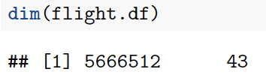
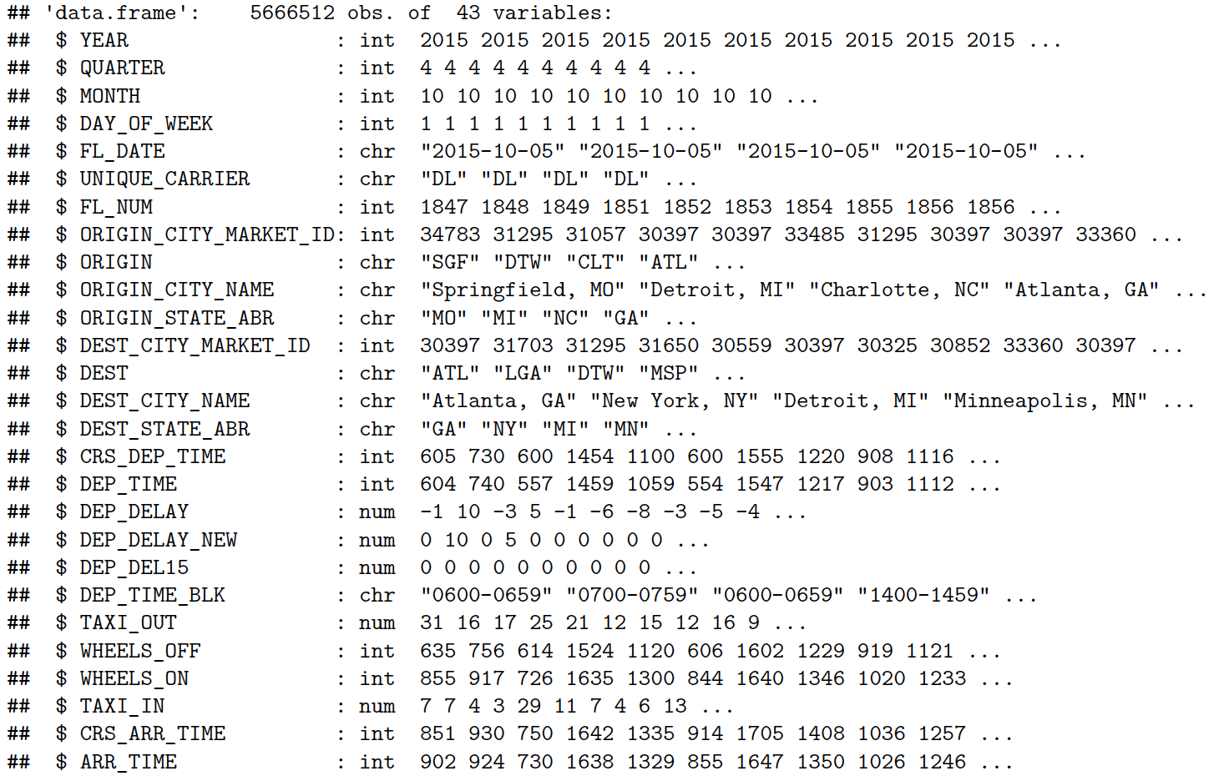

Slide 13
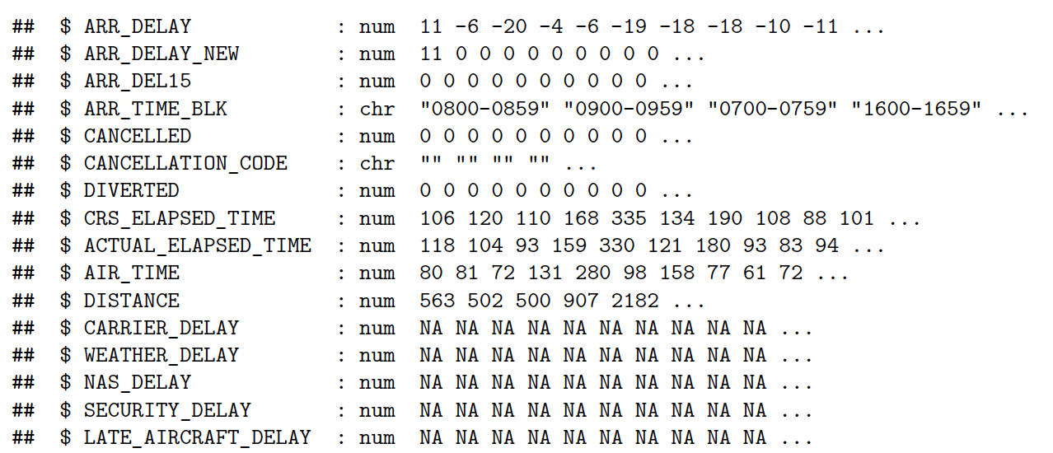

Slide 14
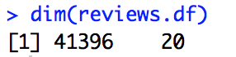
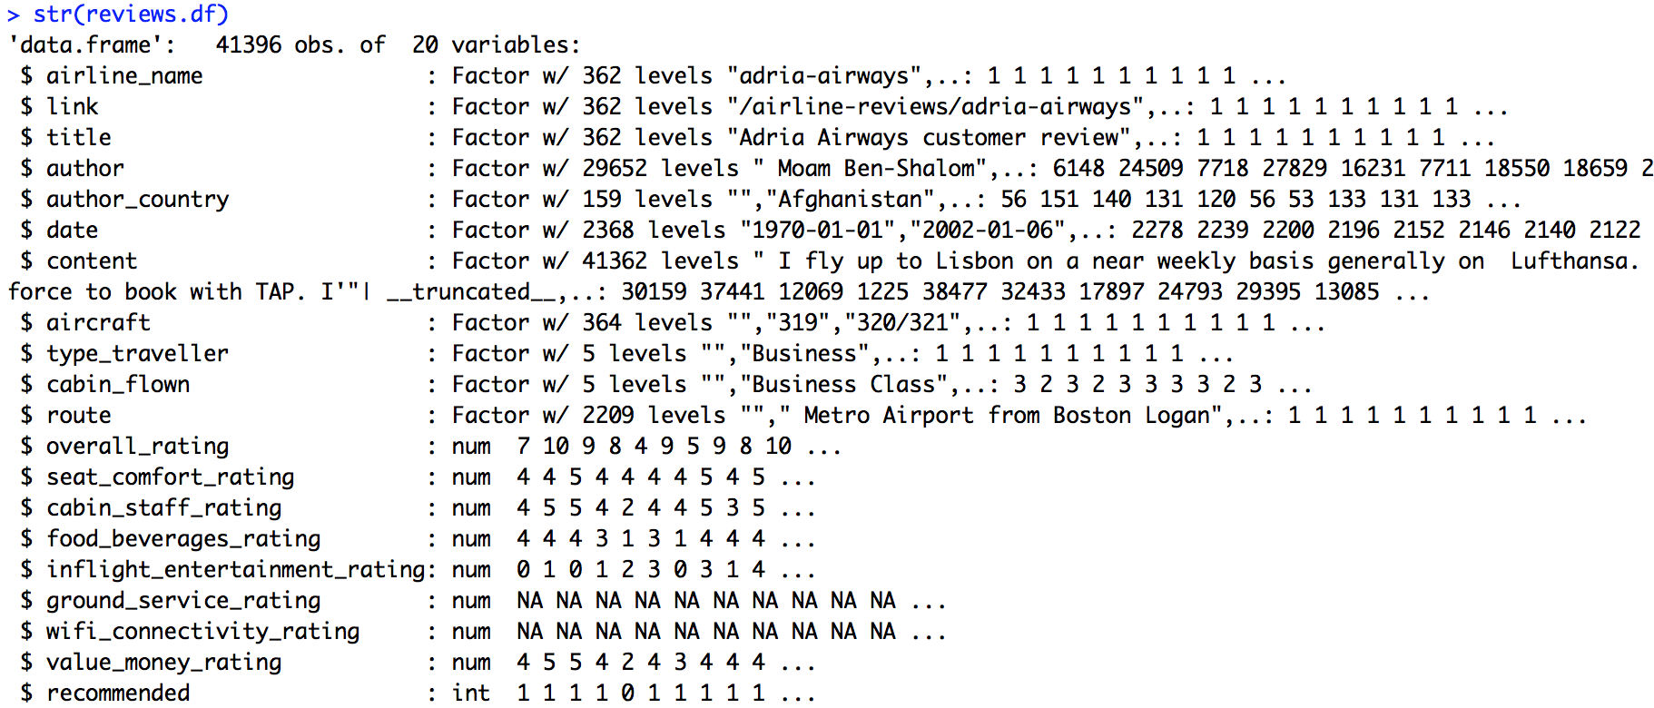

Slide 15
R Analysis
02
Variable summaries and visualizations

Slide 16
How many flights did each carrier operate during past year?
Which carrier has the largest/least number of flights?

Slide 17
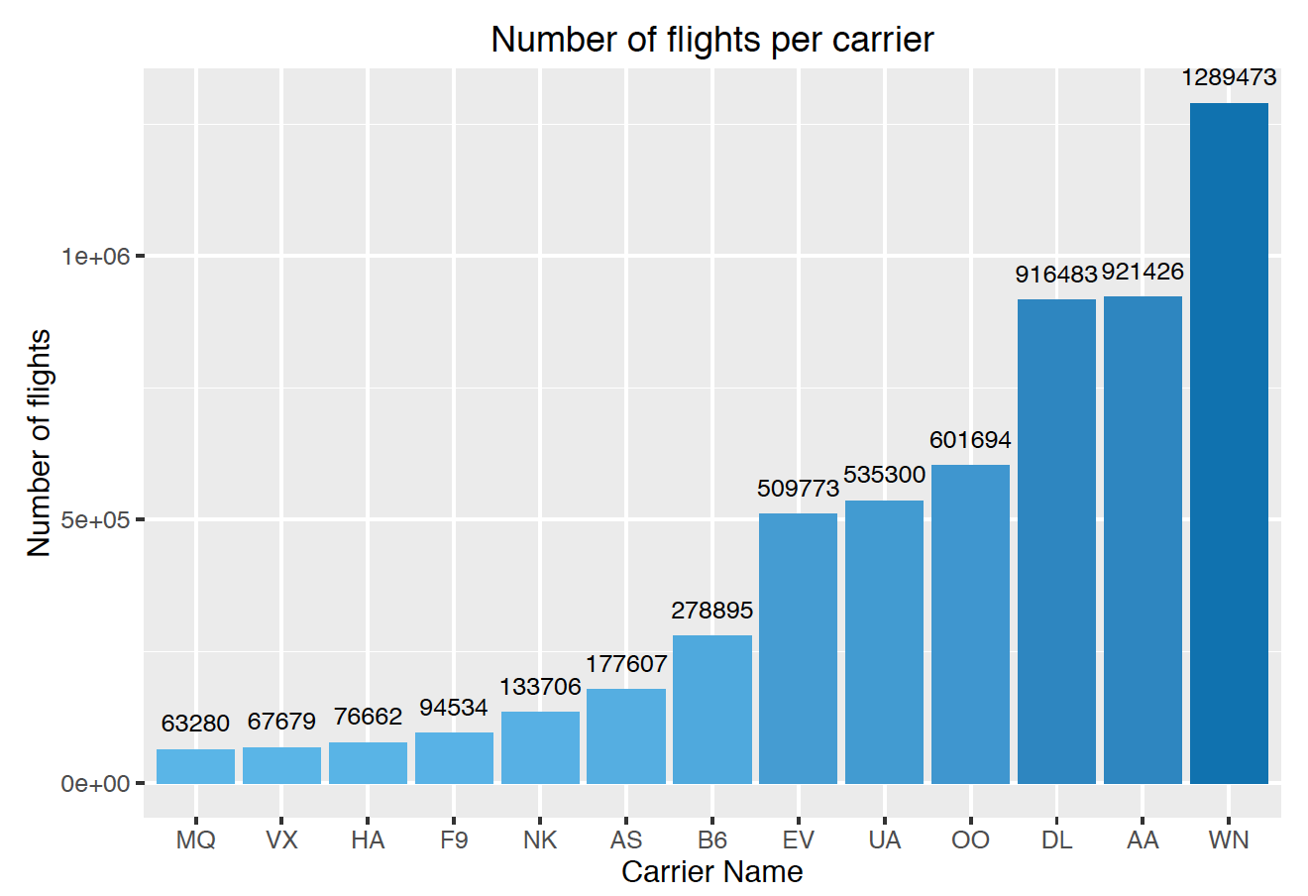
We observe that Southwest Airlines(WN) has the largest number of flights followed by American Airlines(AA). Envoy Air(MQ) has the least.

Slide 18
Which carrier is the most widely distributed?

Slide 19
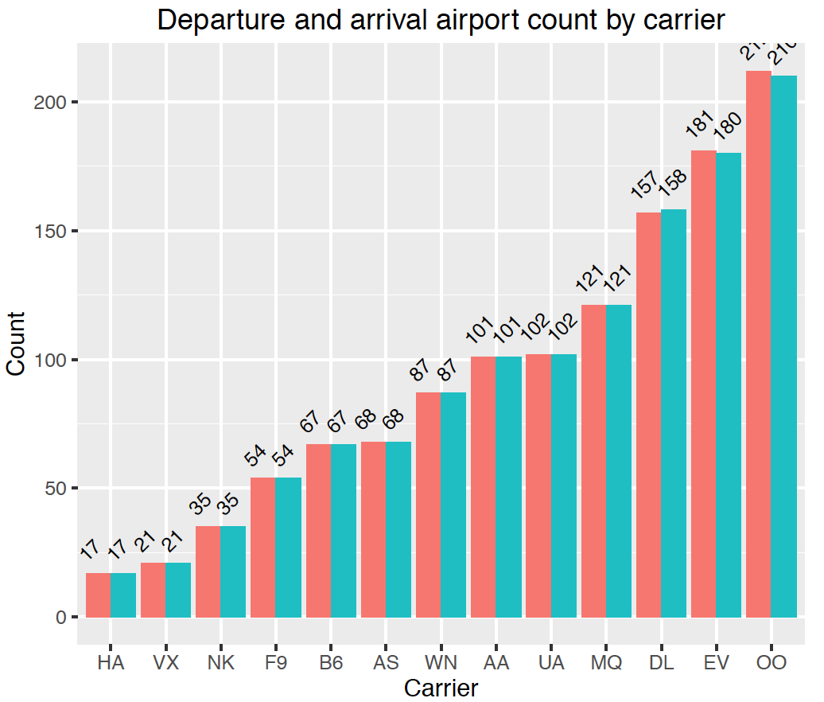
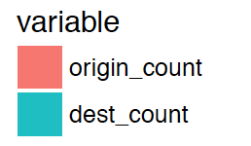
OO (SkyWest Airlines) has the maximum number of departure and arrival airports which is more than 210.
HA (Hawaiian Airlines) has the least number of departure and arrival airports which is only 17.

Slide 20
Which month is the busiest month of the year?

Slide 21
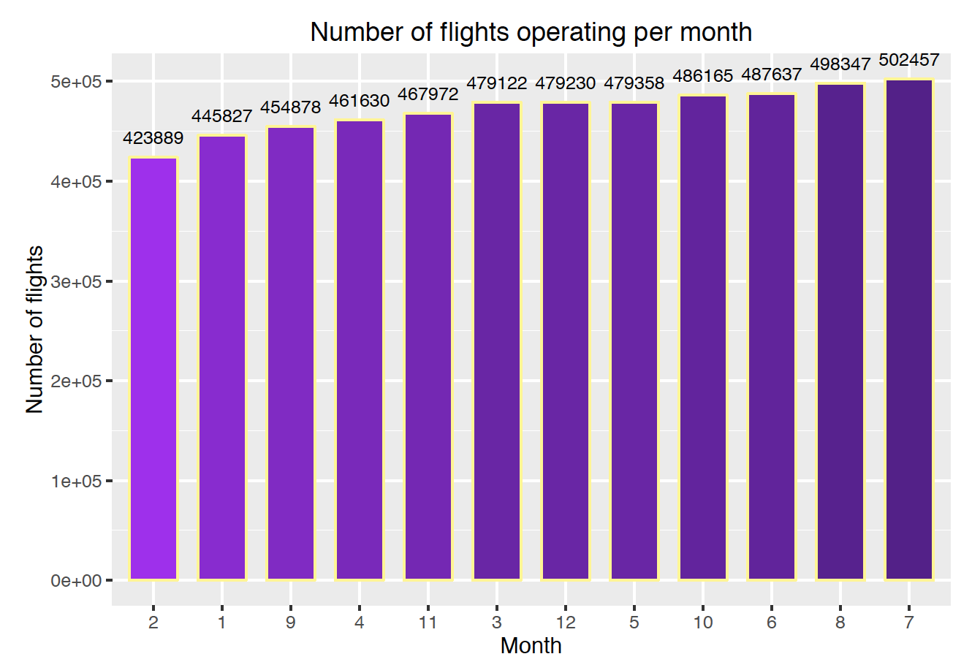

Slide 22
Which day is the busiest day of the week?

Slide 23
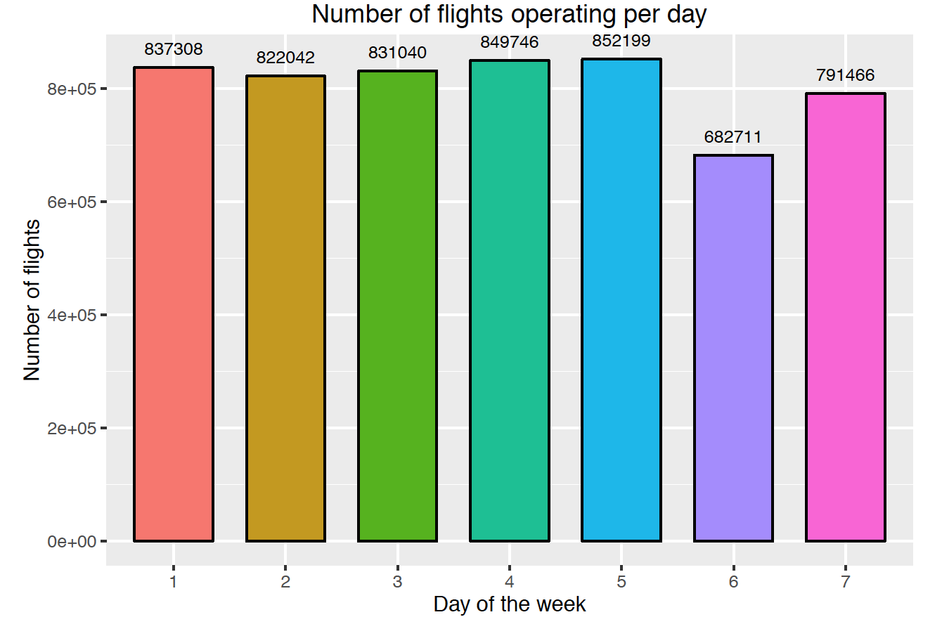
We observe that higher number of flights are operated on Thursday and Friday. A smalll number of flights are operated on Saturday.

Slide 24
How about the On-time Arrival Performance of last year?

Slide 25
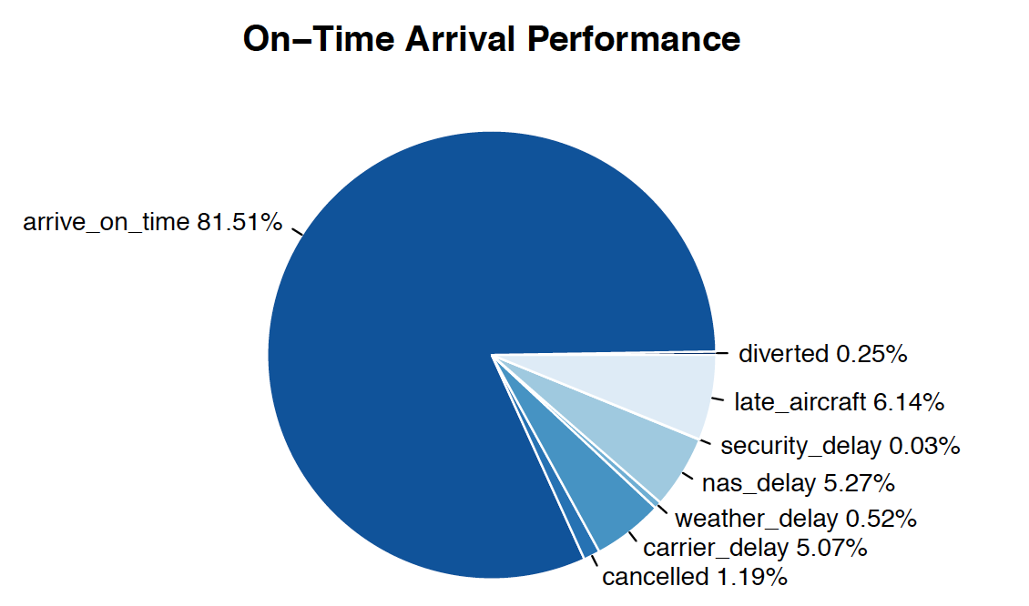

Slide 26
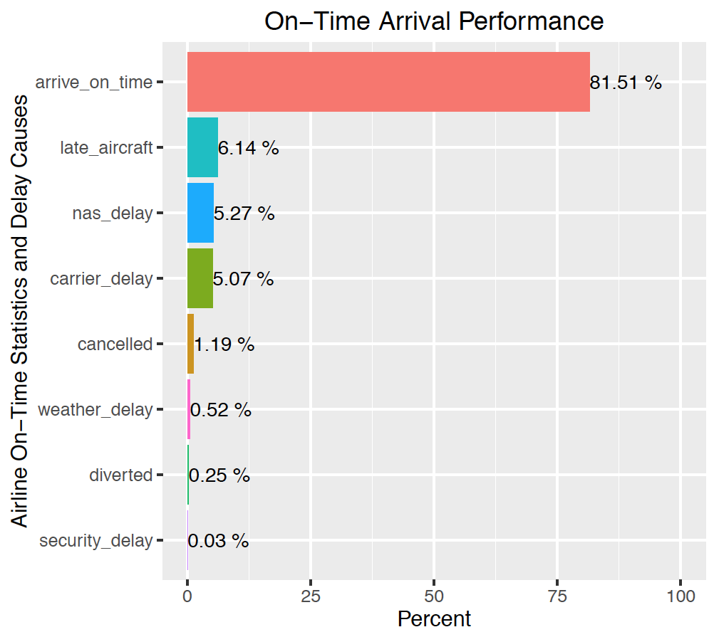
81.51% flights arrived on time, 1.19% flights were cancelled and 0.25% flights were diverted.
About 18.49% flights are delayed and most of the delays occur due to late aircraft which contributes to 6.14% of all flights. It is followed by nas delay, carrier delay, weather delay and security delay .

Slide 27
So, How about the flights cancellation rate per carrier?

Slide 28
Which carrier most frequently cancel their flights?

Slide 29
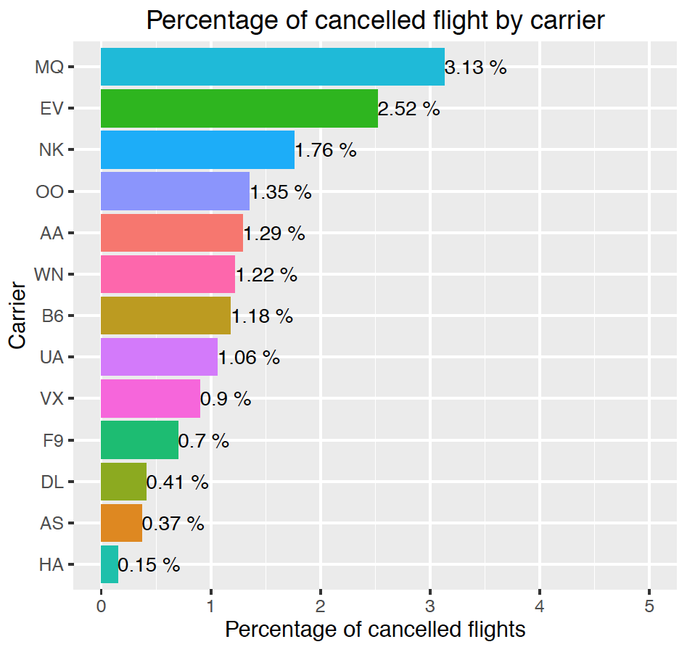
Envoy Air (MQ) has the maximum percentage of cancellations followed by EV (ExpressJet Airlines).
HA (Hawaiian Airlines) has the least percentage of cancellations.

Slide 30
So, How about the flights delay time and delay rate?

Slide 31
Which time period of the day is most likely to take off late?

Slide 32
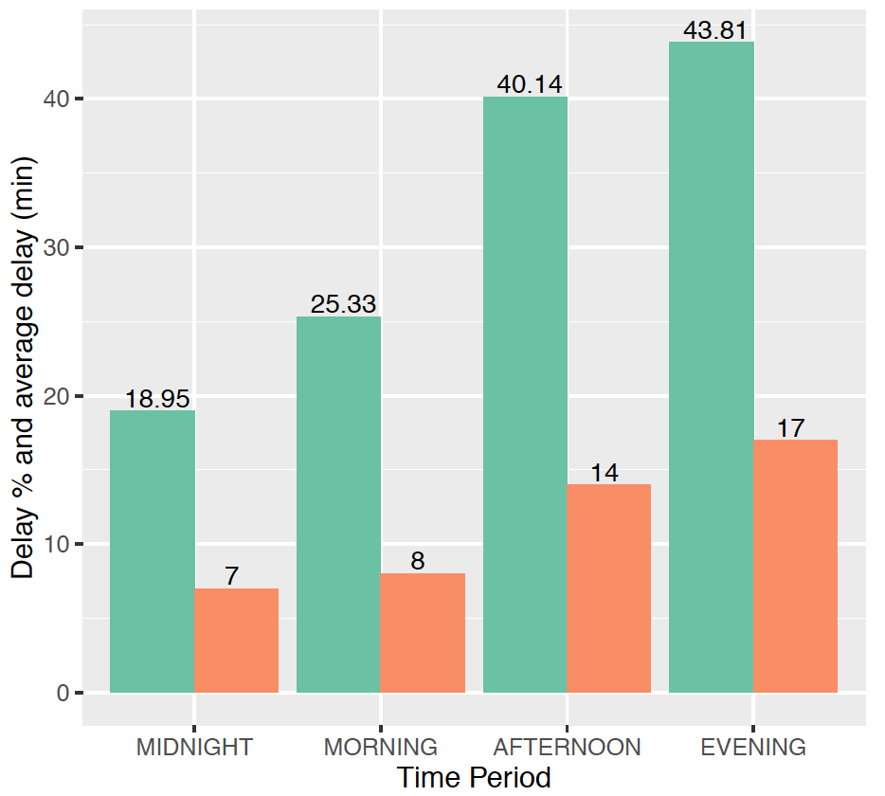
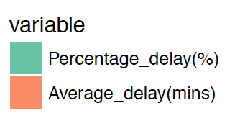
Departure delay distribution over the day period
In the evening period(6-12pm), both of departure delay percentage and average delay time reached the highest value of 43.81% and 17 minutes respectively.
On the contrary, around midnight both of these values are relatively low that is 18.95% and 7 minutes respectively.

Slide 33
Top 10 Worst Destination Airports ranked by Average Arrival Delay Time and Delay Rate

Slide 34
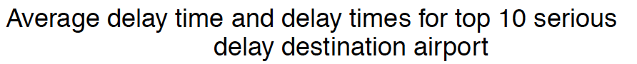
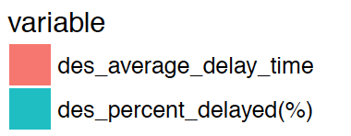
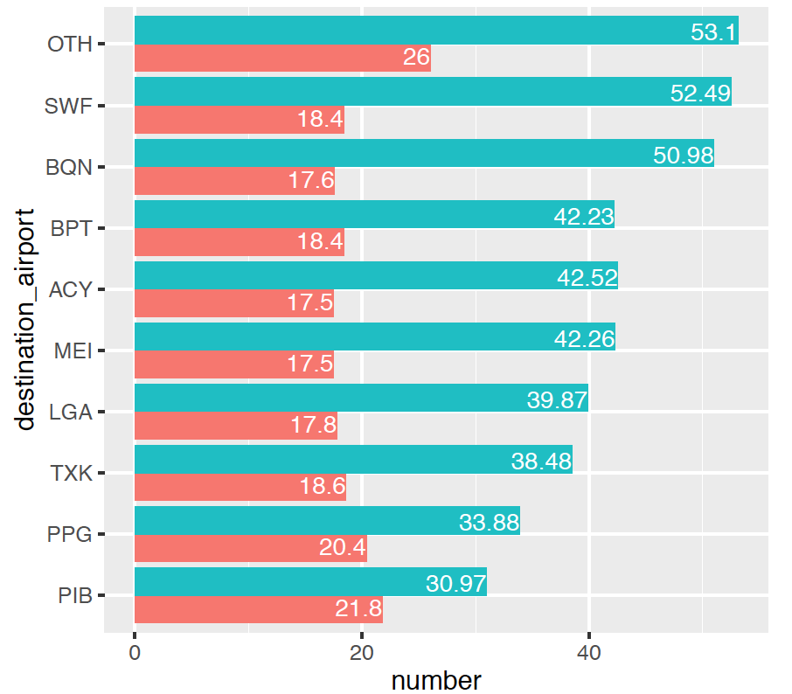
During last year, all top 10 destination airports have more than 17 minutes arrival delay and more than 30% flights arrived late.
OTH (Southwest Oregon Regional Airport) has the maximum average delay time of 26 minutes and its percent delayed is also high that is 53.1% of flights that arrived late at this airport.

Slide 35
Top 10 Worst Origin Airports ranked by Average Departure Delay Time and Delay Rate

Slide 36
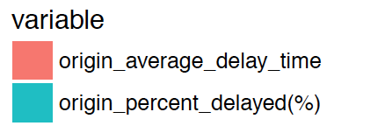
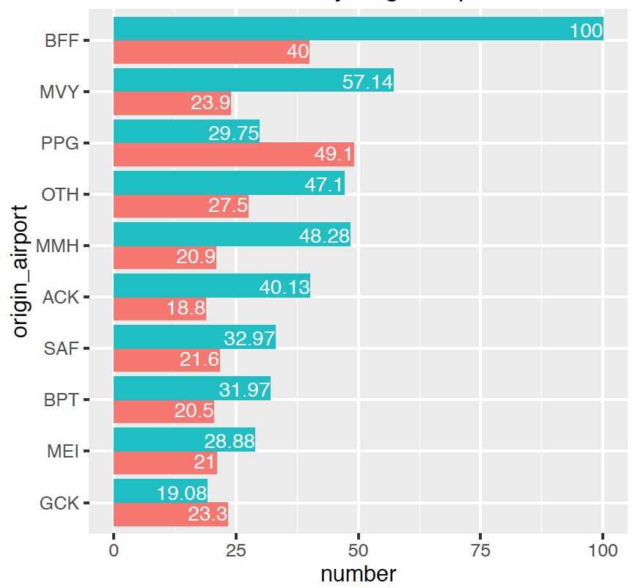
During last year, all top 10 origin airports have more than 18 minutes arrival delay and more than 19% flights arrived late.
BFF (Western Nebraska Regional Airport)
has the maximum percent delayed which is 100% of flights departure late at this airport and its average delay time is also high that is 40 minutes.
PPG (Pago Pago International Airport) has the maximum average delay time of 49.1 minutes and 29.15% of flights departure late at this airport.

Slide 37
R Analysis
03
Text Mining: Word Cloud

Slide 38
What about passengers' impressions of each airline?

Slide 39
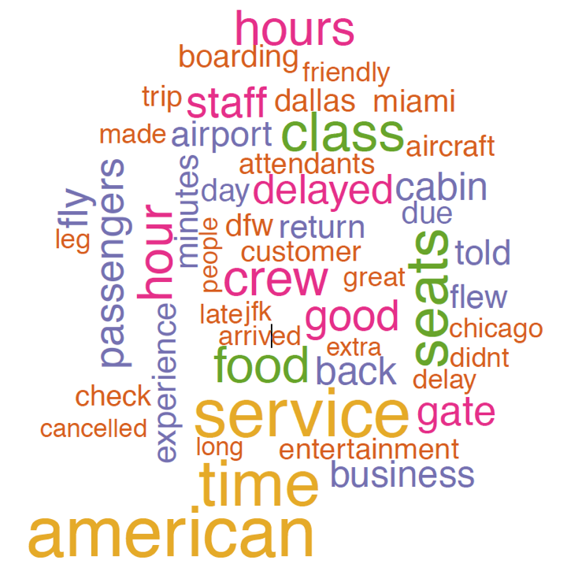
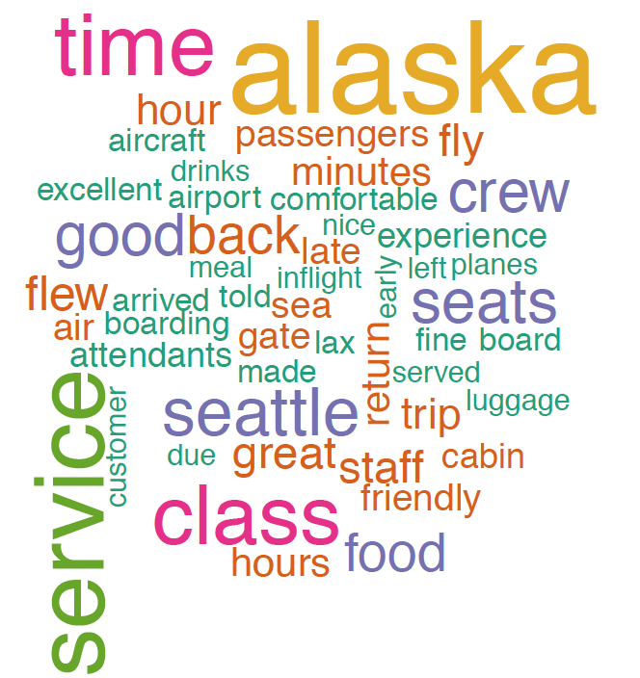
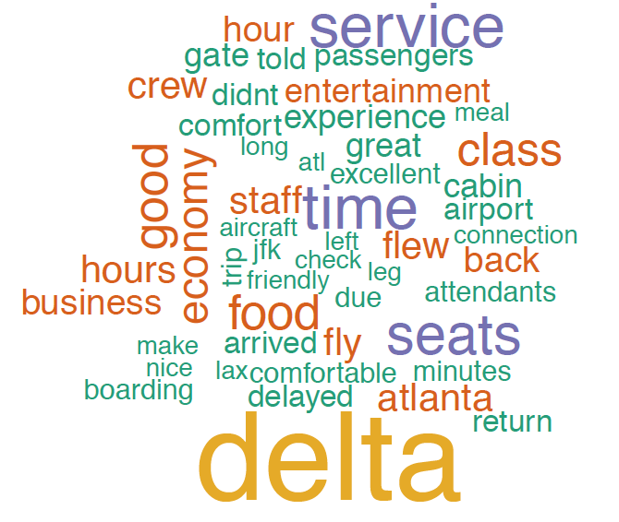
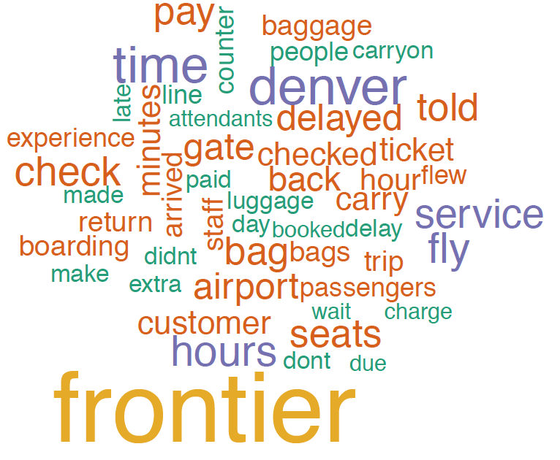
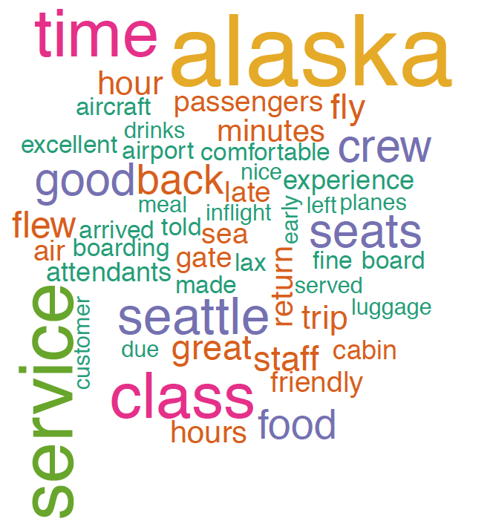
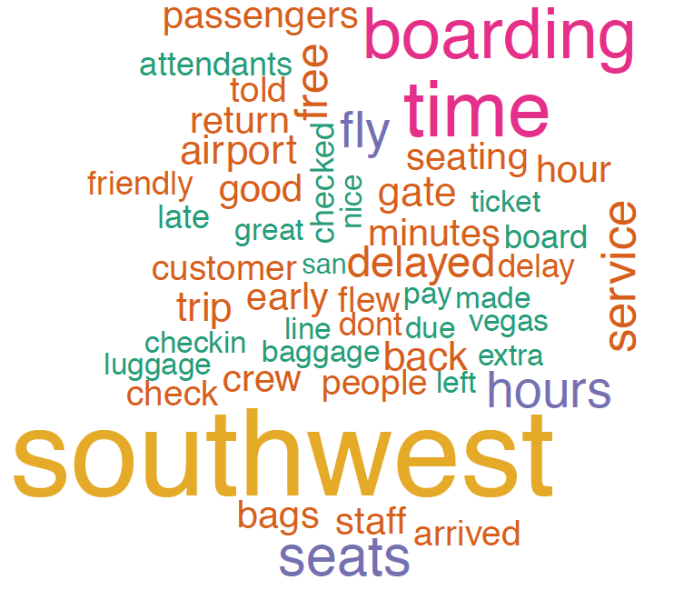
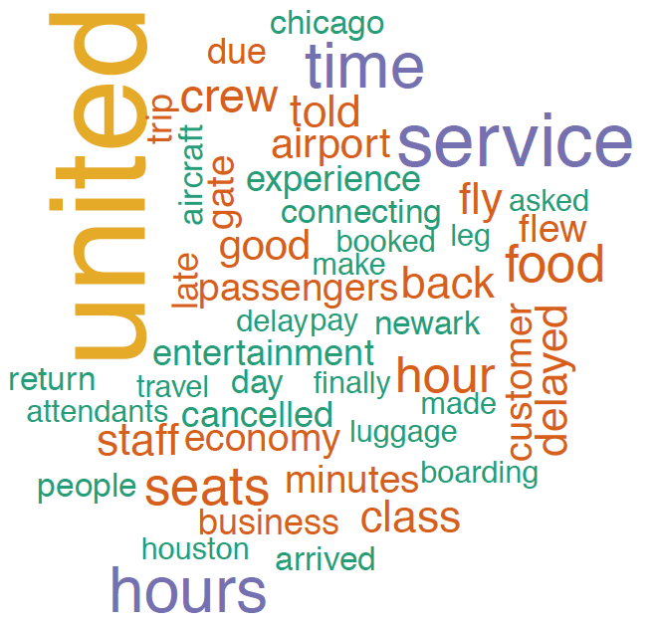
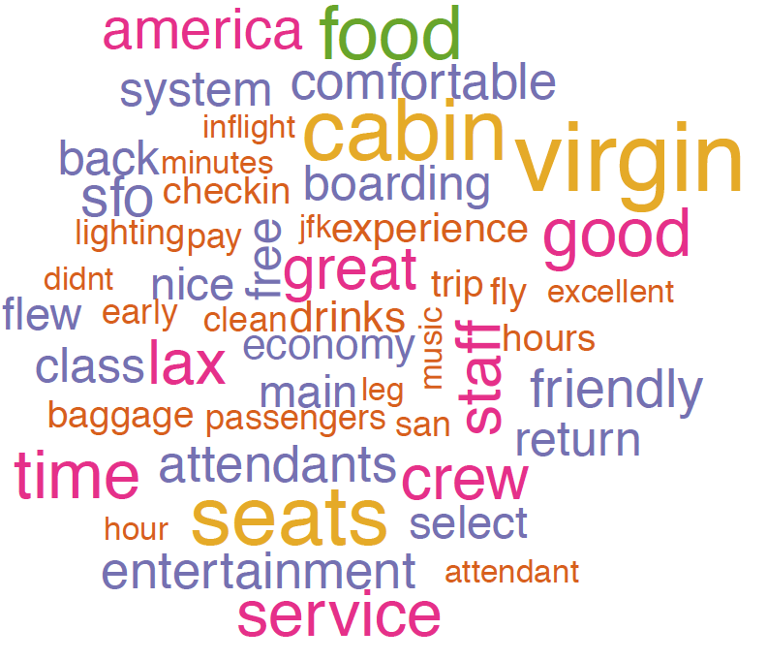
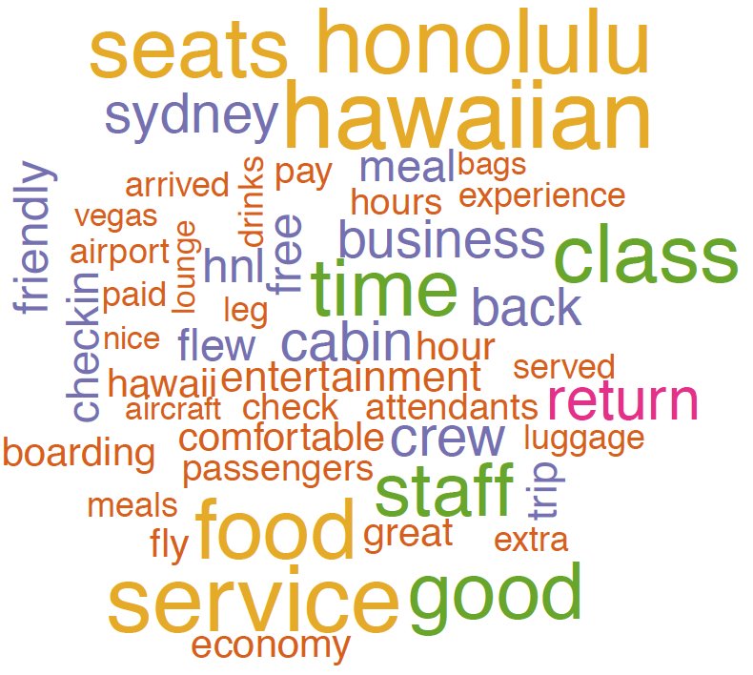
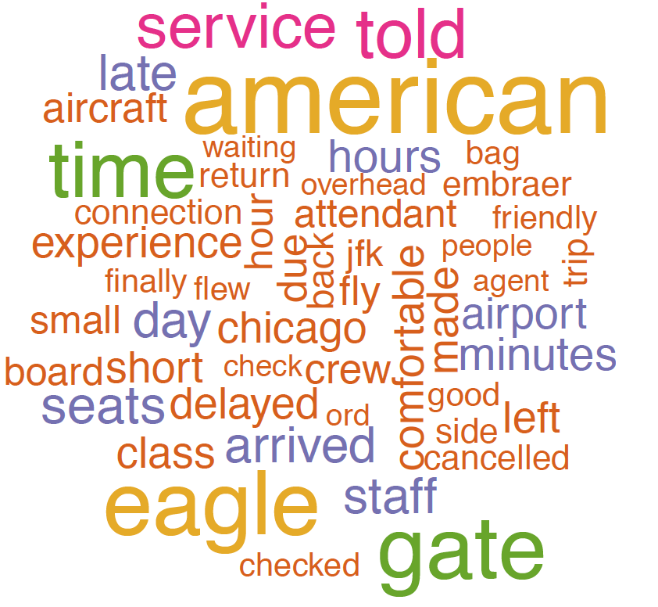
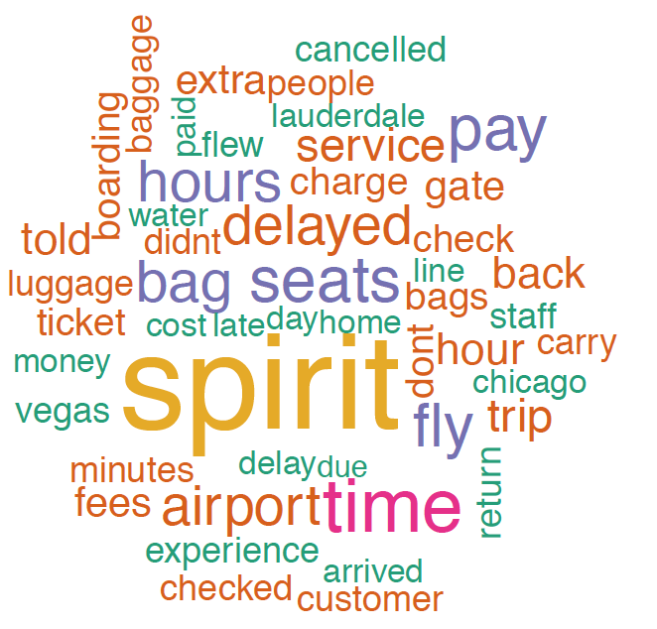
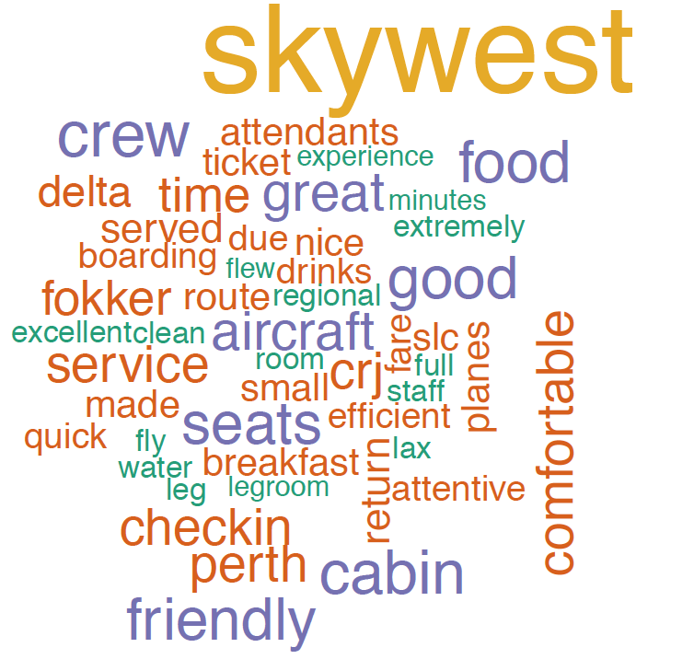

Slide 40
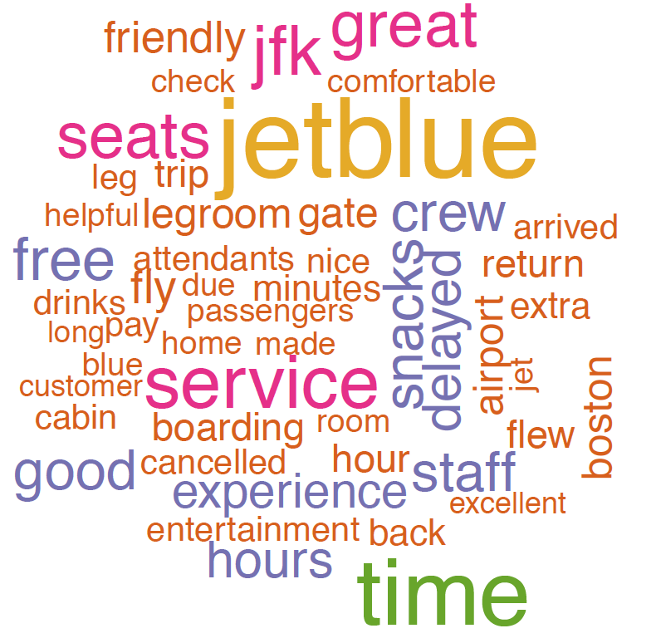

Slide 41
Hadoop
2

Slide 42
Hadoop
Using over 5 million flight records we downloaded from the Bureau of Transportation Department. We use Hadoop to achieve 3 main goals:
Calculate the delay rate, average delay time and average air time for each flight.
Calculate average customer review score
Store the result into HBase.
Notes:
Store the result into HBase. So that we can query the data from the website.

Slide 43

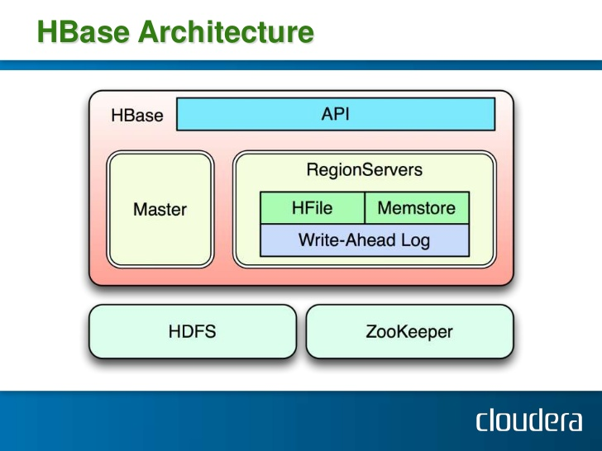
HBase
Apache HBase is the Hadoop database that is used for a distributed, scalable, big data store.
Random, real time read/write access to Big data.
Key/value storage. Fast query using key.
Notes:
Apache HBase is the Hadoop database that is used for a distributed, scalable, big data store. It is different from traditional database. It is a NoSQL database that runs on top the Hadoop cluster and provides random real-time read/write access to the data. it stores key/value pairs in columnar fashion.

Slide 44
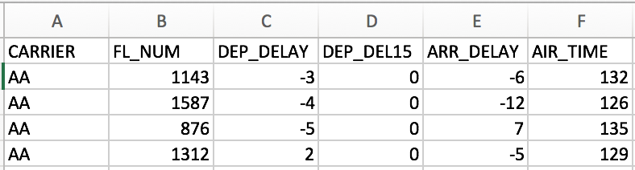
Data Preparation
Select Attributes:
CARRIER
FL_NUM: Flight number
DEP_DELAY: Departure delay time
ARR_DELAY: Arrival delay time
DEP_DEL15: Delay indicator
AIR_TIME: Time that the airplane is on air

Slide 45
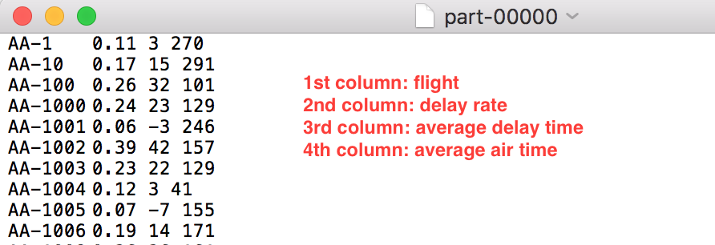
Hadoop
Mapper:
Read csv files and generate key value pairs, where
Key: <Carrier + flightNum>
Value: <delayIndicator, arrDelayTime, depDelayTime, airTime>
Reducer:
Do the summation and generate average delay time
Output(before insert into HBase):
Notes:
Store the result into HBase. So that we can query the data from the front-end.

Slide 46
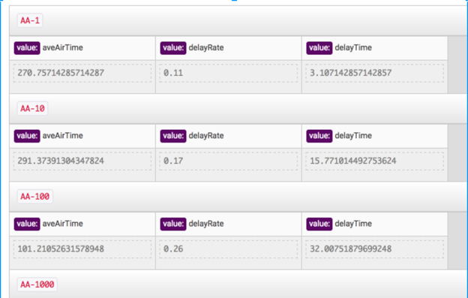
Hadoop

Slide 47
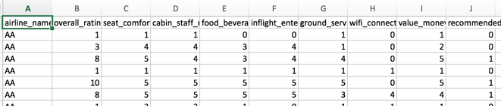
Hadoop for Passenger Review
Select Attributes:
Carrier
Overall_rating
Comfort_rating
Food_rating

Slide 48
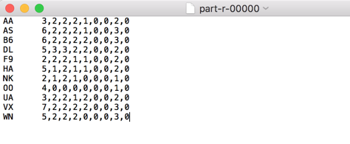
Average Rating Score for airline company

Slide 49
Machine Learning
3

Slide 50
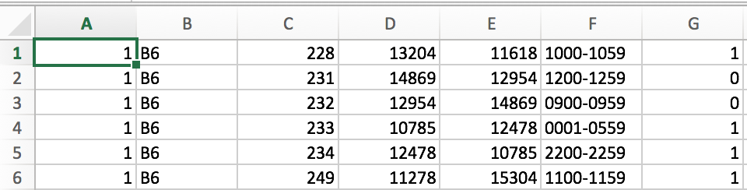
Logistic Regression
Independent Variables:
Day Of Week
Origin Airport
Destination Airport
Flight number
Departure Time Block
Dependent Variable:
Delay or not(0 = on time, 1 = delay)
Notes:
We also do some machine learning based on our dataset. We use logistic Regression to predict whether a flight will be delayed. The independent variables are...the dependent variable is …. The program read about 17 thousand records.

Slide 51
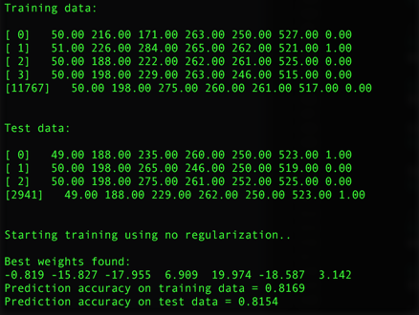
Training with no regularization
Notes:
First we train the data with no regularization. and here is some of the training data and test data. the prediction accuracy is about 80%.

Slide 52
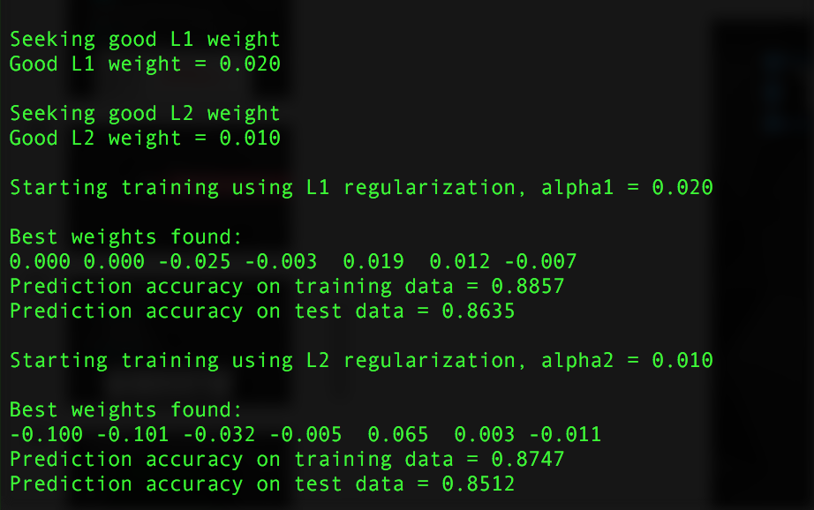
Training with regularization
Notes:
Then we optimized our algorithm by using L1 regularization and L2 regularization. The prediction accuracy on test data improved by 5%. The final predication accuracy is 86%

Slide 53
Display
4

Slide 54
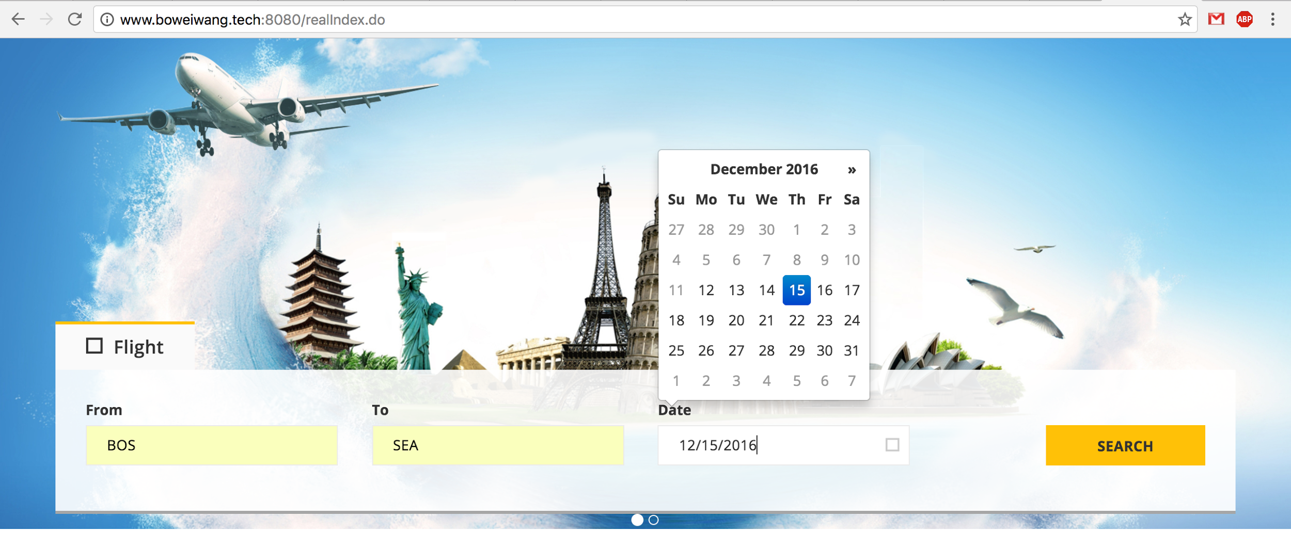
CONTENTS

Slide 55
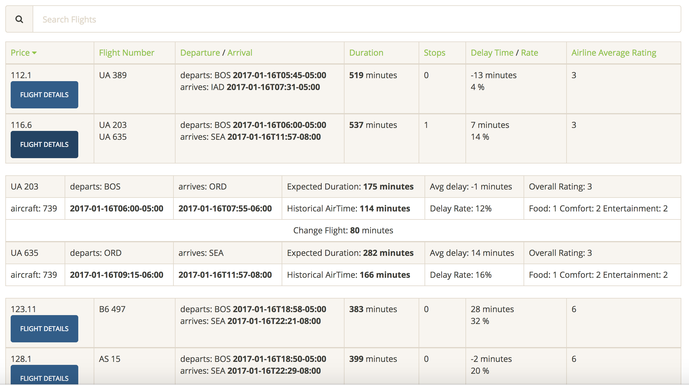
CONTENTS

Slide 56
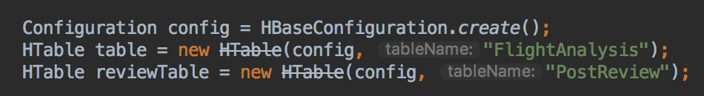
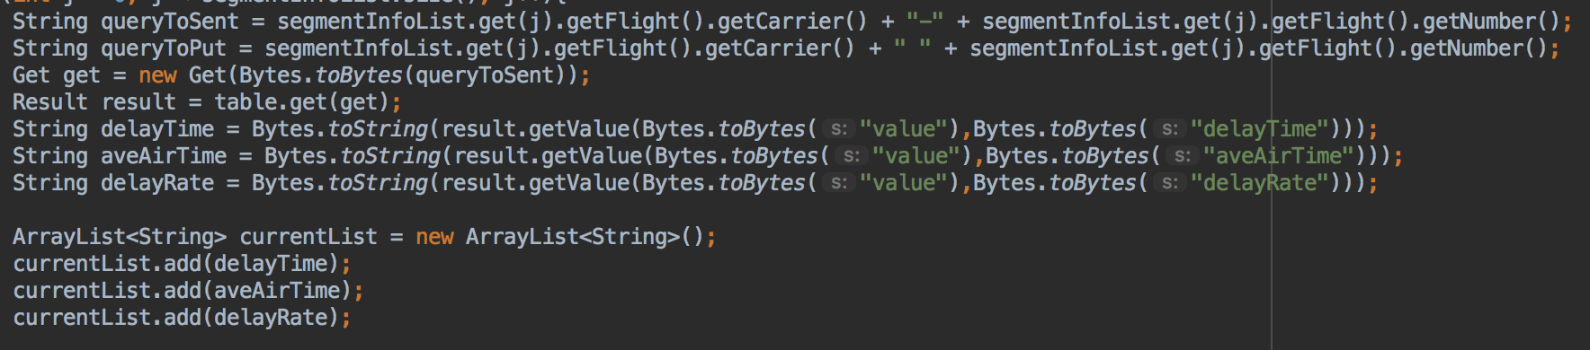
HBase configuration

Slide 57
Future Scope
Extend another weather data source to help the customer have a better understanding about what should he/she expect during the travel.
Combine all the different delay factors like historical delay time, delay probability, weather factors, routing and airline reputation to build a comprehensive calculation model to make the decision for the customer
Add purchase link for the end user to directly purchase the ticket through our web site.

Slide 58
THANKS FOR LISTENING

